Slide 1
16010123214 Om Anand Jha
16010123215 Om Bhanushali
16010123216 Om Lanke
16010123217 Om Thanage
16010123218 Omik Acharya
16010123219 Omkar Dinde
16010123220 Omkar Desai

Slide 2
Introduction
Our project utilizes IoT technology, ultrasonic sound, and TDS sensors, all integrated with an ESP32 microcontroller.
It aims to provide a comprehensive solution for monitoring water levels and assessing water quality in real-time.
The system offers cost-effective and efficient water management, detecting issues such as water quality problems and potential leaks.
It addresses global concerns about water scarcity and quality while ensuring scalability and adaptability through IoT technology.

Slide 3


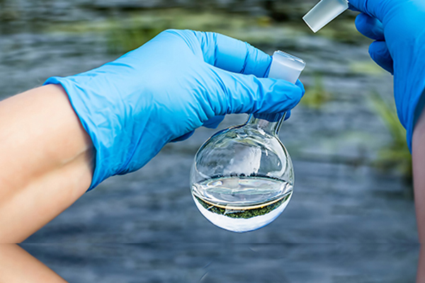
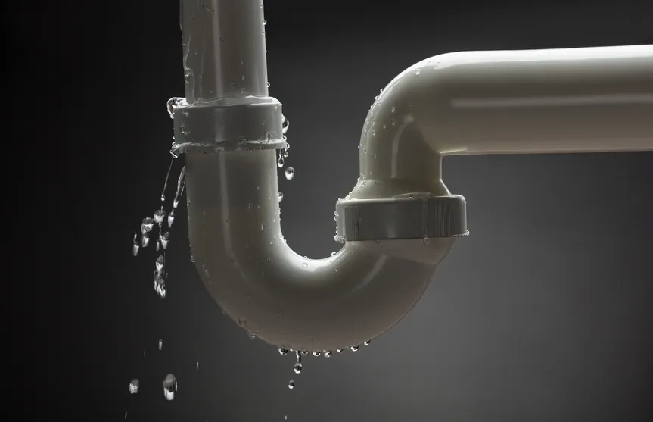

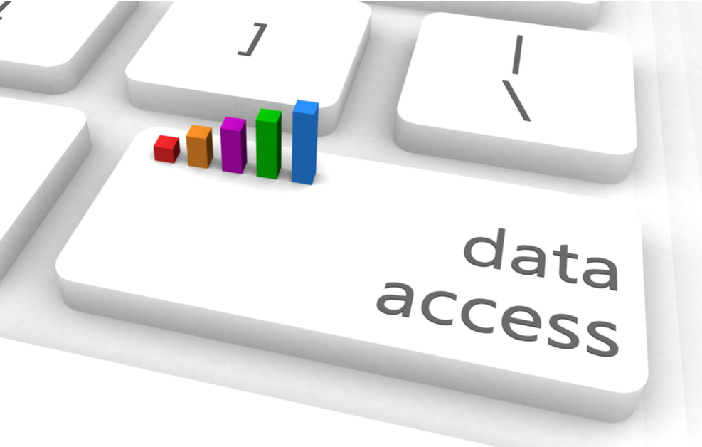
Problems we handle
Inaccurate Water Level Monitoring |  | Manual Data Collection
Resource Wastage |  | Data Accessibility

Slide 4

SOLUTION

Slide 5


Slide 6
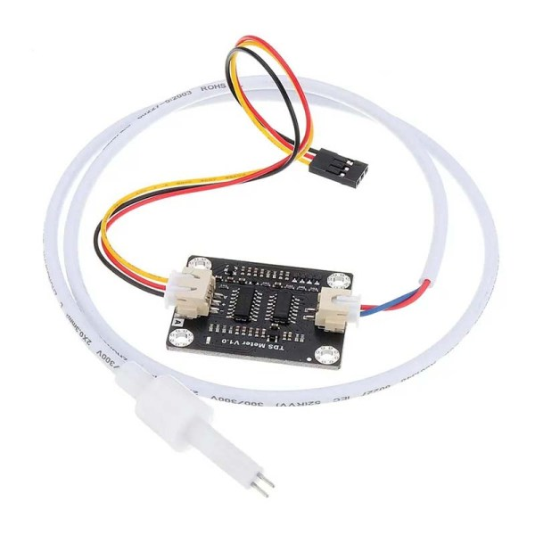
Components
TDS Sensor
DS18B20WP
HC-SR04
ESP32
A TDS sensor, or Total Dissolved Solids sensor, is a device used to measure the concentration of dissolved solids in a liquid.
It is commonly employed in water quality testing and analysis.
Other things

Slide 7
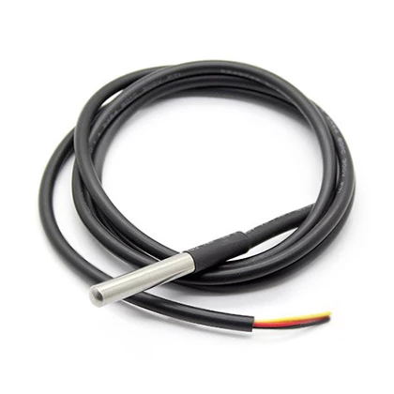
Components
TDS Sensor
DS18B20WP
HC-SR04
The DS18B20WP is a specific variant of the DS18B20 digital temperature sensor.
It is designed to measure temperature and provide digital temperature data.
ESP32
Other things

Slide 8
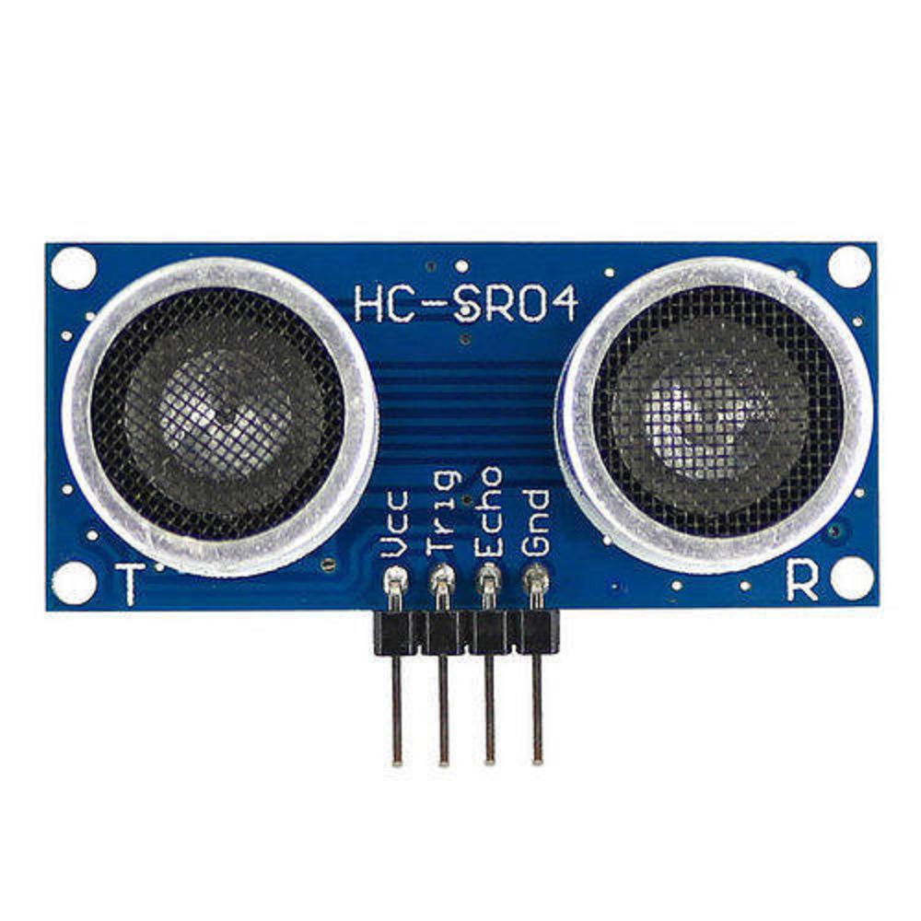
Components
TDS Sensor
DS18B20WP
HC-SR04
The HC-SR04 is an ultrasonic distance sensor module that is commonly used for measuring distances.
It operates on the principle of sending and receiving ultrasonic sound waves to determine the distance to an object.
ESP32
Other things

Slide 9
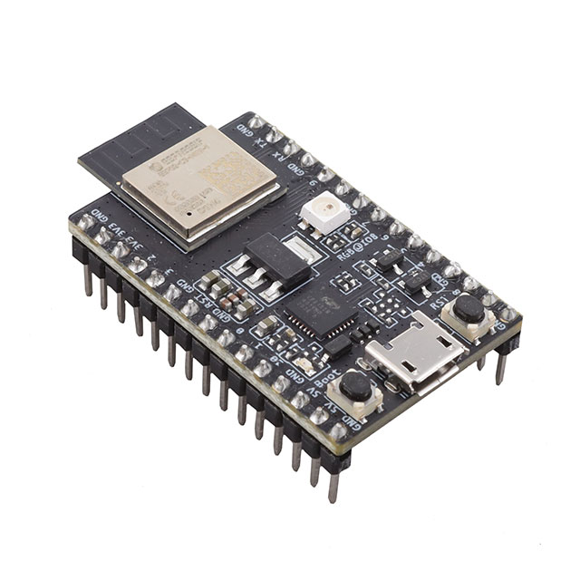
Components
TDS Sensor
DS18B20WP
HC-SR04
The ESP32 is both a microcontroller and a system-on-chip (SoC) that combines a microcontroller unit (MCU) with a Wi-Fi and Bluetooth stack, making it suitable for IoT and wireless communication applications.
ESP32
Other things

Slide 10
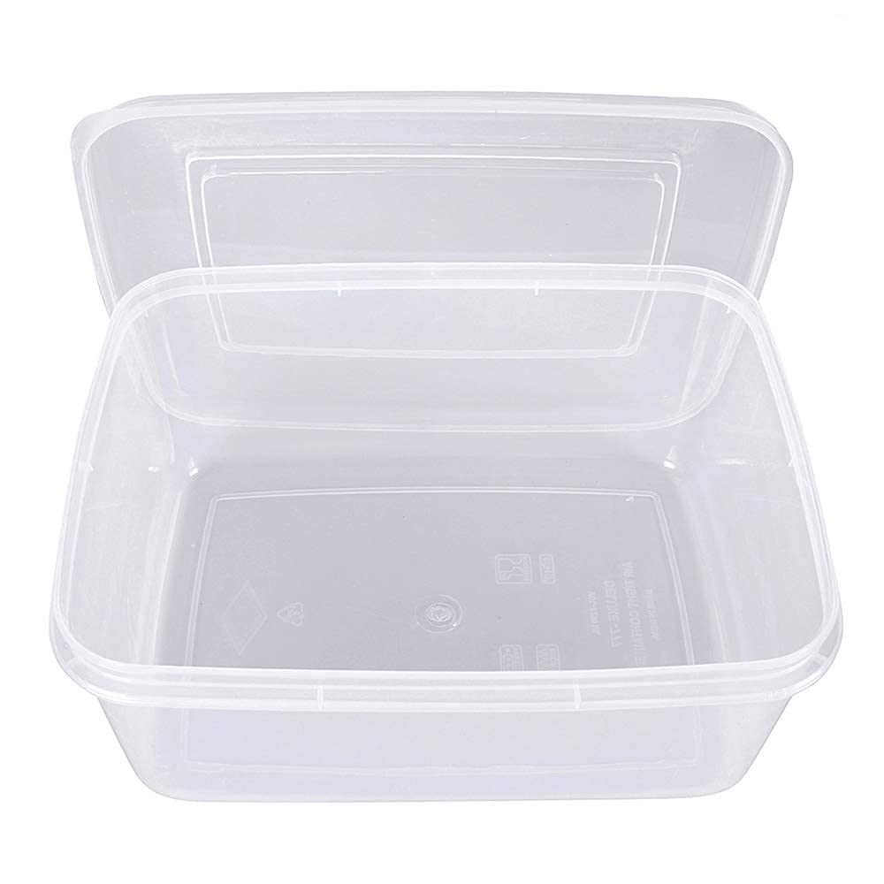
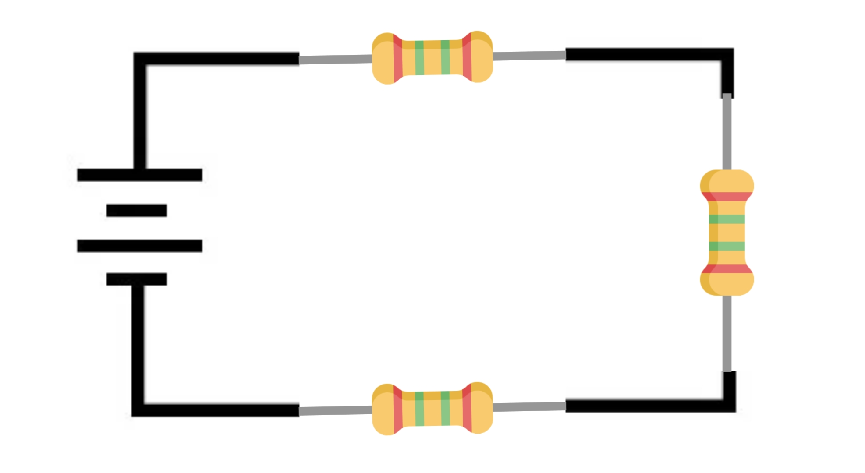
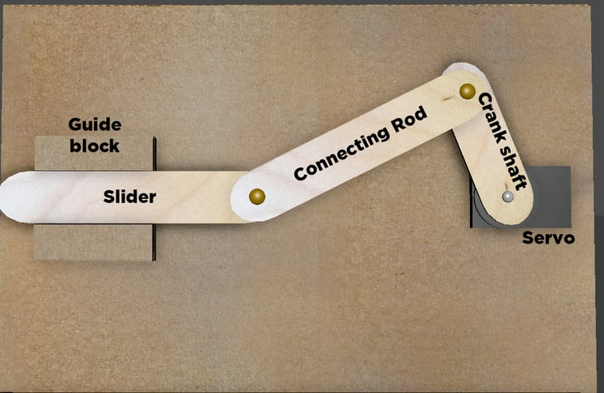
Components
TDS Sensor
DS18B20WP
Plastic box
Power supply & 3 Resistors
HC-SR04
ESP32
Other things
Slider

Slide 11
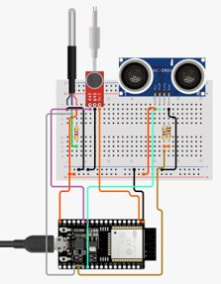
Circuit diagram

Slide 12
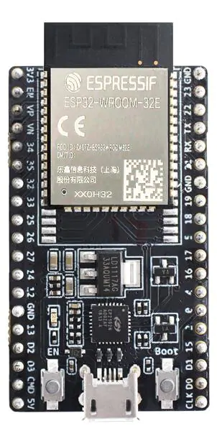

SETUP FOR A WATER TANK
SENSOR
Water Input
PROCCESSING UNIT
ESP32
Length of water tank
WATER
Slider
TDS SENSOR
DS18B20WP
Water Outlet

Slide 13
How it’s measured?

Slide 14
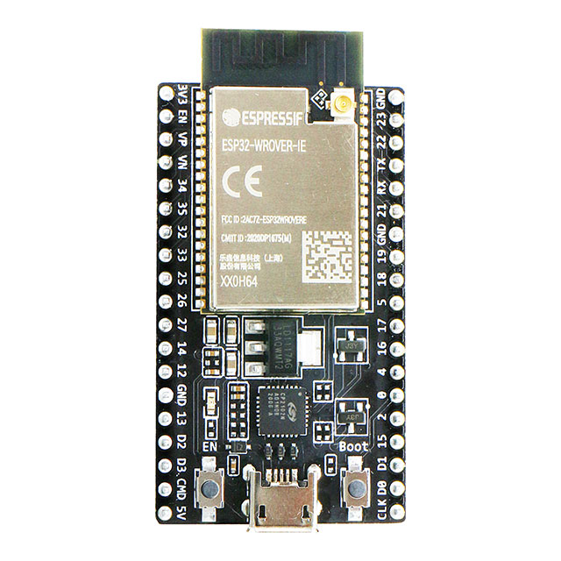


WATER availability
The HC-SR04 ultrasonic sensor employs sound waves to precisely measure distances. Operating on a principle of emitting a pulse and subsequently capturing the returning echo, it then employs precise timing calculations to determine the distance. This data is seamlessly relayed to the ESP32 for further processing and analysis, facilitating accurate and real-time distance measurements.
Data collection
Processing
Output

Slide 15
Hardness
Electric current is passed
Resistance is converted to TDS value
Esp32 send data through Wi-Fi
TDS sensor goes back to its original position
TDS sensor probe are dipped in water
A TDS sensor with probes measures dissolved solids in a liquid. It uses electrical conductivity between probes. More solids mean better conductivity. Resistance is measured and converted to a TDS value, usually in ppm or mg/L.

Slide 16
Temperature sensor(DS18B20WP) measures temperature
12-digit value obtained is converted to °C using ESP32
Data is transmitted through Wi-fi and stored in a database.
Temperature
The DS18B20WP stands as a waterproof digital temperature sensor distinguished by its individual 64-bit address. Following a temperature conversion command, it meticulously gauges the temperature and transmits a precise 12-bit digital value to the ESP32. Remarkably, this sensor demonstrates exceptional accuracy within a broad temperature range, spanning from -55°C to +125°C.

Slide 17
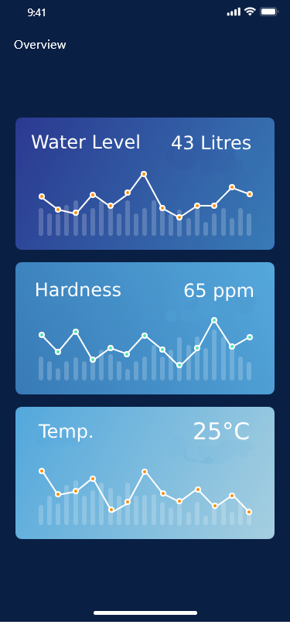
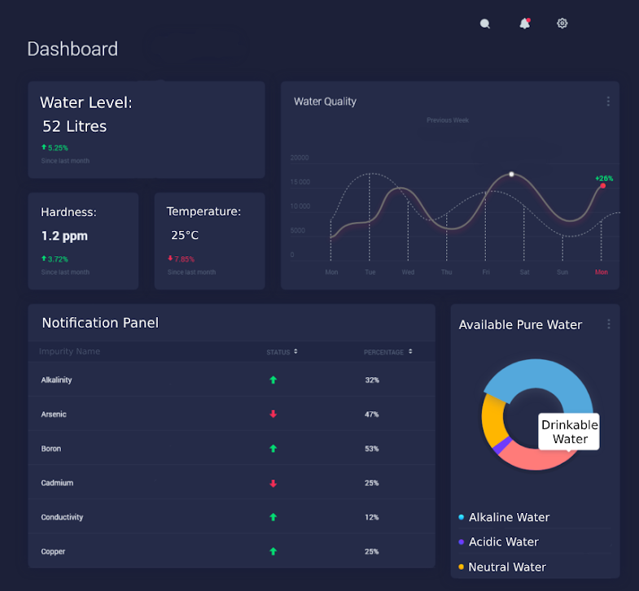
Processing and Output
The data collected is processed with the help of ESP32 and storage in a database using Wi-Fi.
The processed data is creatively displayed on any screen.

Slide 18
Few points to consider
Maintenance
Precautions
The Tds sensor probes need to be cleaned after every 10 readings with little detergent and distilled water. If not cleaned it will give incorrect reading as salts get deposited on probe.​
Clean the HCR-S04 and temperature sensor at a stretch of two months otherwise it will cause a coating build-up on the sensor.
The temperature of water should be below 70°C and cannot be used to measure flowing water.​

Slide 19
Cost
Component | Cost (price may vary)
TDS Sensor with slider | 350
DS18B20WP | 200
HC-SR04 | 50
ESP32 | 200
Power Supply, Resistors | 60
Total :- ₹860

Slide 20
Conclusion
The device accurately measures temperature, water availability, and water hardness, providing reliable data for a range of applications.
The system allows for real-time monitoring and data logging, enhancing its usefulness in various scenarios.
There is potential for even more precise measurements and the inclusion of additional environmental parameters in future developments.
Our project represents a significant step towards democratizing access to crucial environmental data and contributing to a more sustainable future.

Slide 21
QNA

Slide 22


